Slide 1




My Algebra Interactive Notebook
$$3ab$$
$$2x+3y$$
$$\frac{5xy}{6}$$
Name :
Class :
Term 2 Semester 1
$$y=2x+1$$

Slide 2
Contents
Glossary
Page
Date
Description
2
3

Slide 3
Tasks
24
7
30
Essential Question
Questions
Notes
Summary
4
7

Slide 4
24
7
30
Date
Simplifying Expressions
EQ – How do I simplify if the terms are multiplied or divided?

Slide 5
24
7
30
Date
Simplifying Expressions
EQ – How do I simplify if the terms are multiplied or divided?
What happens to the x sign?

Slide 6
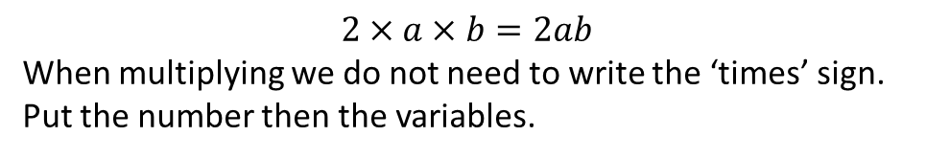
24
7
30
Date
Simplifying Expressions
EQ – How do I simplify if the terms are multiplied or divided?
$$2×a×b=2ab$$
When multiplying we do not need to write the ‘times’ sign.
Put the number then the variables.
What happens to the x sign?

Slide 7

24
7
30
Date
Simplifying Expressions
EQ – How do I simplify if the terms are multiplied or divided?
$$2×a×b=2ab$$
When multiplying we do not need to write the ‘times’ sign.
Put the number then the variables.
What happens to the x sign?
$$3xy ×4m$$
(This means $3×x×y×4×m$)
Examples:

Slide 8
24
7
30
Date
Simplifying Expressions
EQ – How do I simplify if the terms are multiplied or divided?
$$2×a×b=2ab$$
When multiplying we do not need to write the ‘times’ sign.
Put the number then the variables.
What happens to the x sign?
$$3xy ×4m$$
(This means $3×x×y×4×m$)
Examples:
Multiply the numbers first and then put the letters together.

Slide 9

24
7
30
Date
Simplifying Expressions
EQ – How do I simplify if the terms are multiplied or divided?
$$2×a×b=2ab$$
When multiplying we do not need to write the ‘times’ sign.
Put the number then the variables.
What happens to the x sign?
$$3xy ×4m$$
(This means $3×x×y×4×m$)
Examples:
Multiply the numbers first and then put the letters together.
$$3×4×m×x×y$$
$=12mxy$

Slide 10




24
7
30
Date
Simplifying Expressions
EQ – How do I simplify if the terms are multiplied or divided?
$$2×a×b=2ab$$
When multiplying we do not need to write the ‘times’ sign.
Put the number then the variables.
What happens to the x sign?
$$3xy ×4m$$
(This means $3×x×y×4×m$)
Examples:
Multiply the numbers first and then put the letters together.
$$3×4×m×x×y$$
$=12mxy$
Something harder: $4x×3z×2xyz$
$$4×3×2×x×x×y×z×z$$
$$4×3×2$$
$$x×x=x^{2}$$
Only 1 $y$
$$z×z=z^{2}$$
$$=24x^{2}yz^{2}$$

Slide 11





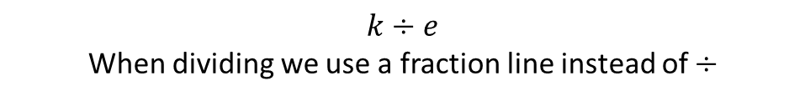


24
7
30
Date
Simplifying Expressions
EQ – How do I simplify if the terms are multiplied or divided?
$$3xy ×4m$$
(This means $3×x×y×4×m$)
Examples:
Multiply the numbers first and then put the letters together.
$$3×4×m×x×y$$
$=12mxy$
Something harder: $4x×3z×2xyz$
$$4×3×2×x×x×y×z×z$$
$$4×3×2$$
$$x×x=x^{2}$$
Only 1 $y$
$$z×z=z^{2}$$
$$=24x^{2}yz^{2}$$
$$k÷e$$
When dividing we use a fraction line instead of $÷$
What happens to the $÷$ sign?
Thus: $= \frac{k}{e}$

Slide 12


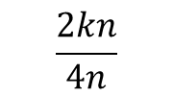



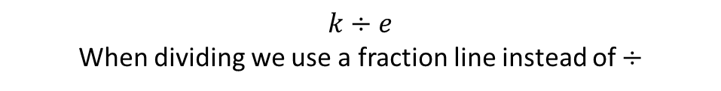
24
7
30
Date
Simplifying Expressions
EQ – How do I simplify if the terms are multiplied or divided?
Something harder: $4x×3z×2xyz$
$$4×3×2×x×x×y×z×z$$
$$4×3×2$$
$$x×x=x^{2}$$
Only 1 $y$
$$z×z=z^{2}$$
$$=24x^{2}yz^{2}$$
What happens to the $÷$ sign?
$$k÷e$$
When dividing we use a fraction line instead of $÷$
Thus: $= \frac{k}{e}$
Examples:
Simplify
$$\frac{2kn}{4n}$$
Cancel common factors

Slide 13
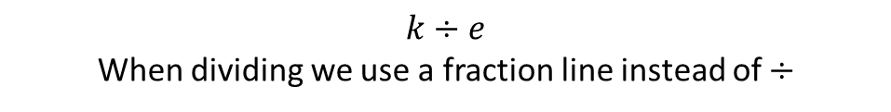


24
7
30
Date
Simplifying Expressions
EQ – How do I simplify if the terms are multiplied or divided?
What happens to the $÷$ sign?
$$k÷e$$
When dividing we use a fraction line instead of $÷$
Thus: $= \frac{k}{e}$
1
Examples:
Simplify
$$\frac{2kn}{4n}$$
Cancel common factors
2

Slide 14
24
7
30
Date
Simplifying Expressions
EQ – How do I simplify if the terms are multiplied or divided?
What happens to the $÷$ sign?
$$k÷e$$
When dividing we use a fraction line instead of $÷$
Thus: $= \frac{k}{e}$
1
Examples:
Simplify
$$\frac{2kn}{4n}$$
Cancel common factors
2

Slide 15

24
7
30
Date
Simplifying Expressions
EQ – How do I simplify if the terms are multiplied or divided?
What happens to the $÷$ sign?
$$k÷e$$
When dividing we use a fraction line instead of $÷$
Thus: $= \frac{k}{e}$
1
Examples:
Simplify
$$\frac{2kn}{4n}=\frac{k}{2}$$
Cancel common factors
2

Slide 16
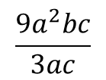
24
7
30
Date
Simplifying Expressions
EQ – How do I simplify if the terms are multiplied or divided?
What happens to the $÷$ sign?
$$k÷e$$
When dividing we use a fraction line instead of $÷$
Thus: $= \frac{k}{e}$
1
Examples:
1. Simplify
$$\frac{2kn}{4n}=\frac{k}{2}$$
Cancel common factors
2
2. Simplify
$$\frac{9a^{2}bc}{3ac}$$

Slide 17
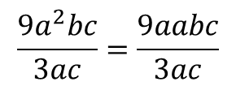
24
7
30
Date
Simplifying Expressions
EQ – How do I simplify if the terms are multiplied or divided?
What happens to the $÷$ sign?
$$k÷e$$
When dividing we use a fraction line instead of $÷$
Thus: $= \frac{k}{e}$
1
Examples:
1. Simplify
$$\frac{2kn}{4n}=\frac{k}{2}$$
Cancel common factors
2
2. Simplify
$$\frac{9a^{2}bc}{3ac}=\frac{9aabc}{3ac}$$

Slide 18
24
7
30
Date
Simplifying Expressions
EQ – How do I simplify if the terms are multiplied or divided?
What happens to the $÷$ sign?
$$k÷e$$
When dividing we use a fraction line instead of $÷$
Thus: $= \frac{k}{e}$
1
Examples:
1. Simplify
$$\frac{2kn}{4n}=\frac{k}{2}$$
Cancel common factors
2
3
2. Simplify
$$\frac{9a^{2}bc}{3ac}=\frac{9aabc}{3ac}$$
1

Slide 19
24
7
30
Date
Simplifying Expressions
EQ – How do I simplify if the terms are multiplied or divided?
What happens to the $÷$ sign?
$$k÷e$$
When dividing we use a fraction line instead of $÷$
Thus: $= \frac{k}{e}$
1
Examples:
1. Simplify
$$\frac{2kn}{4n}=\frac{k}{2}$$
Cancel common factors
2
3
2. Simplify
$$\frac{9a^{2}bc}{3ac}=\frac{9aabc}{3ac}$$
1

Slide 20
24
7
30
Date
Simplifying Expressions
EQ – How do I simplify if the terms are multiplied or divided?
What happens to the $÷$ sign?
$$k÷e$$
When dividing we use a fraction line instead of $÷$
Thus: $= \frac{k}{e}$
1
Examples:
1. Simplify
$$\frac{2kn}{4n}=\frac{k}{2}$$
Cancel common factors
2
3
2. Simplify
$$\frac{9a^{2}bc}{3ac}=\frac{9aabc}{3ac}$$
1

Slide 21
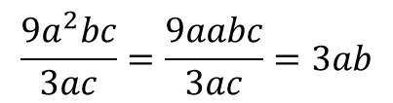
24
7
30
Date
Simplifying Expressions
EQ – How do I simplify if the terms are multiplied or divided?
What happens to the $÷$ sign?
$$k÷e$$
When dividing we use a fraction line instead of $÷$
Thus: $= \frac{k}{e}$
1
Examples:
1. Simplify
$$\frac{2kn}{4n}=\frac{k}{2}$$
Cancel common factors
2
3
2. Simplify
$$\frac{9a^{2}bc}{3ac}=\frac{9aabc}{3ac}=3ab$$
1

Slide 22
24
7
30
Date
Simplifying Expressions
EQ – How do I simplify if the terms are multiplied or divided?
What happens to the $÷$ sign?
$$k÷e$$
When dividing we use a fraction line instead of $÷$
Thus: $= \frac{k}{e}$
1
Examples:
1. Simplify
$$\frac{2kn}{4n}=\frac{k}{2}$$
Cancel common factors
2
3
2. Simplify
$$\frac{9a^{2}bc}{3ac}=\frac{9aabc}{3ac}=3ab$$
1
Page 78-82 Textbooks

Slide 23
Notes Review
24, 7 ,30
Date
Title
Essential question
Notes complete
Notes complete with colour and diagrams
Questions completed
Contents page filled in
Formula page filled in

Slide 24
Homework
Review your notes and write a summary answering the essential question.

